Slide 1


Homomorphic Encryption from RLWE
Schemes and Parameters
Joppe W. Bos
Microsoft Research
Contains joint work with Kristin Lauter, Jake Loftus and Michael Naehrig

Slide 2

Computing on Encrypted Data
Motivation
Outsource data and computation
to an external computing service.
Applications
Spam filter for encrypted mail
Searching on encrypted data
Building block in crypto protocols
Notes:
No motivation here, since everybody knows how cool it would be to have efficient FHE.
Possible applications:
- Spam filter for public-key encrypted email
Searching on encrypted data
Very useful tool for crypto protocols

Slide 3
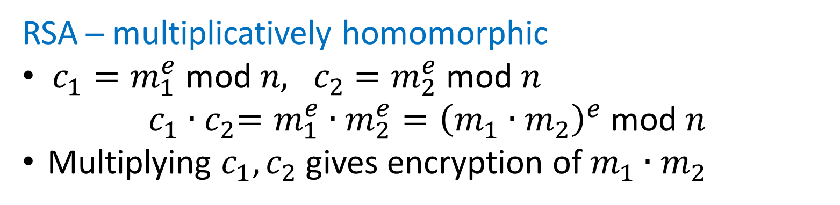
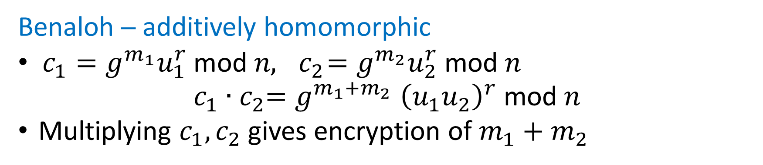
Homomorphic Encryption
RSA ─ multiplicatively homomorphic
$c_{1}=m_{1}^{e} \text{mod} n, { c}_{2}=m_{2}^{e} \text{mod} n$
$c_{1}{∙c}_{2}=m_{1}^{e}∙m_{2}^{e}={\left(m_{1}∙m_{2}\right)}^{e} \text{mod} n$
Multiplying $c_{1},c_{2}$ gives encryption of$m_{1}∙m_{2}$
Benaloh ─ additively homomorphic
$c_{1}=g^{m_{1}}u_{1}^{r} \text{mod} n,{ c}_{2}=g^{m_{2}}u_{2}^{r} \text{mod} n$
$$c_{1}{∙c}_{2}{=g}^{m_{1}+m_{2}}{\left(u_{1}u_{2}\right)}^{r} \text{mod} n$$
Multiplying $c_{1},c_{2}$ gives encryption of $m_{1}+m_{2}$
Notes:
Only one operation possible.
If you want real applications, you need both.

Slide 4

Fully Homomorphic Encryption (FHE)
Enables unlimited computation on encrypted data
Need scheme with unlimited add and mult capability
Idea: Rivest, Adleman, Dertouzos (1978)
Boneh-Goh-Nissim (2005): unlimited add + 1 mult
Breakthrough: Gentry (2009) showed
such schemes exist
A lot of progress since then
Gentry, Halevi, Smart (2012): homomorphic evaluation of AES
5 minutes per block (16 bytes)
Totally and utterly impractical!
Totally impractical!
Notes:
Pairings in BGN.
Note on bit encryption!
For doing 1 block only, fastest implementation could handle 54 blocks in parallel, about 40 minutes per block.
Can do an implementation with 720 blocks in parallel, about 5 minutes per block.

Slide 5
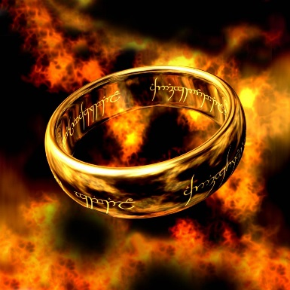
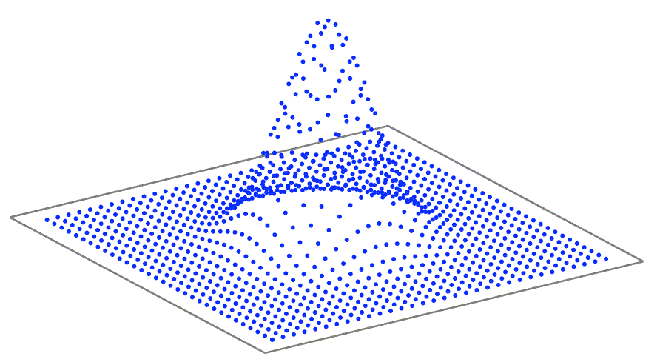
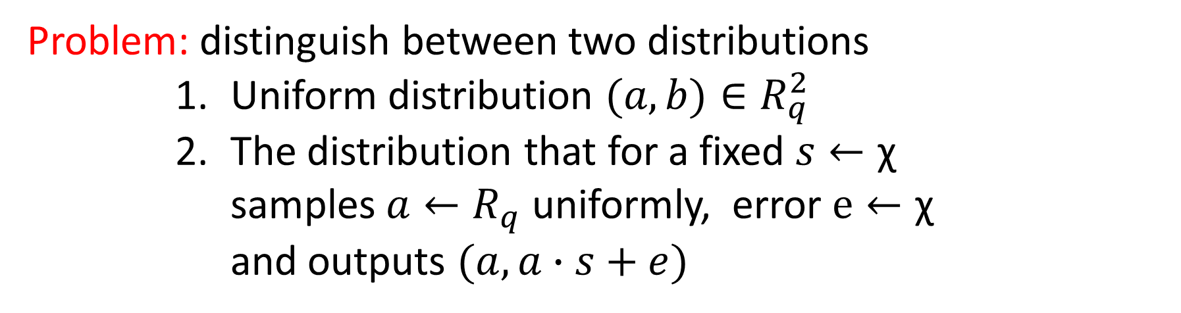
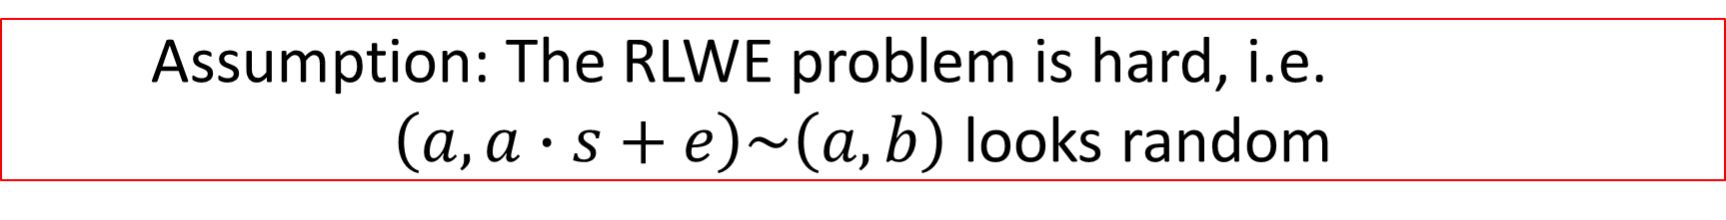
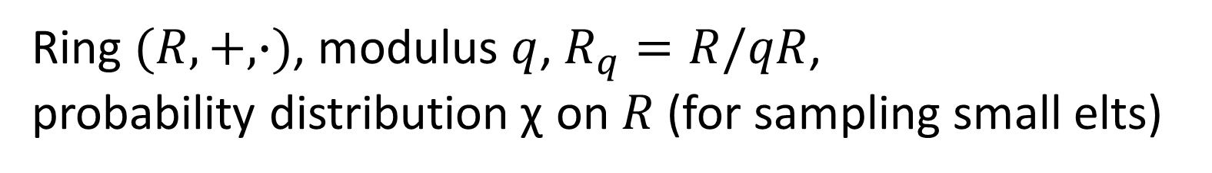
Ring Learning With Errors (RLWE)
(Lyubashevsky, Peikert, Regev 2010)
Ring $(R,+,∙)$, modulus $q$, $R_{q}=R/qR$,
probability distribution$\text{χ}$ on $R$ (for sampling small elts)
Problem: distinguish between two distributions
      Uniform distribution $(a,b)∈R_{q}^{2}$
      The distribution that for a fixed $s←\text{χ}$
      samples $a←R_{q}$ uniformly, error $e←\text{χ}$
      and outputs $(a, a∙s+e)$
Assumption: The RLWE problem is hard, i.e.
$\left(a,a∙s+e\right)\sim \left(a,b\right)$ looks random

Slide 6
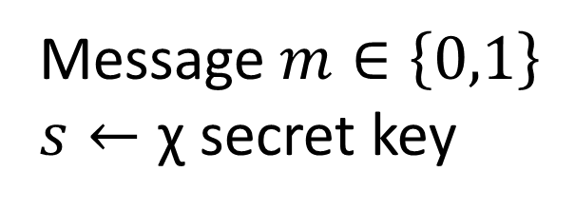
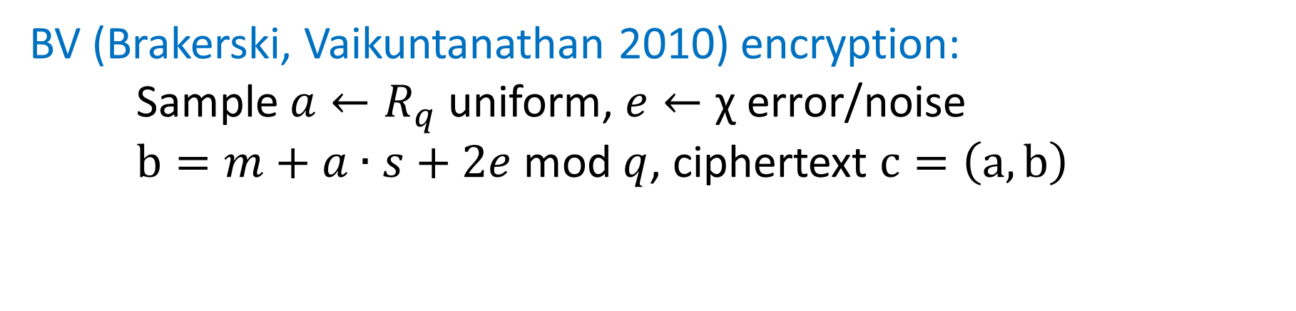
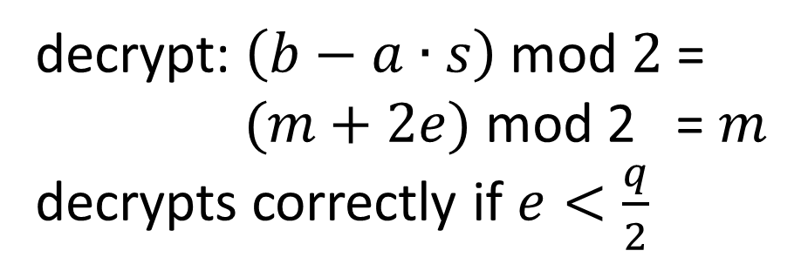
(Symmetric) Encryption from RLWE
Message $m∈\left\{0,1\right\}$
$s←\text{χ}$ secret key
BV (Brakerski, Vaikuntanathan 2010) encryption:
Sample $a←R_{q}$ uniform, $e←\text{χ} \text{error}\text{/}$noise
$b=m+a∙s+2e$ mod $q$, ciphertext $c=\left(a, b\right)$
decrypt: $\left(b−a∙s\right)$ mod $2$=
$(m+2e)$ mod 2 = $m$
decrypts correctly if $e<\frac{q}{2}$

Slide 7
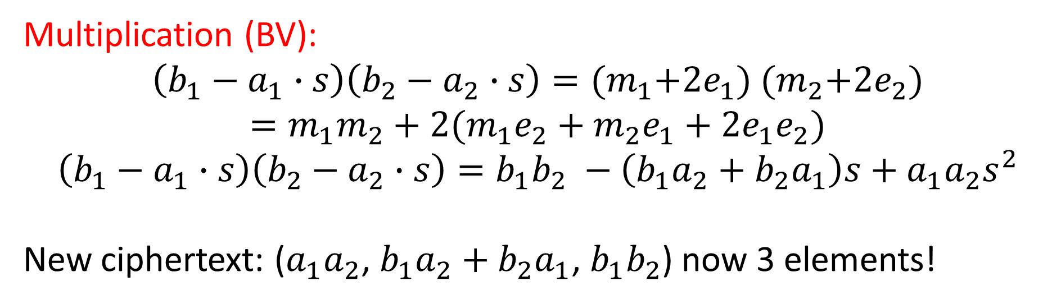
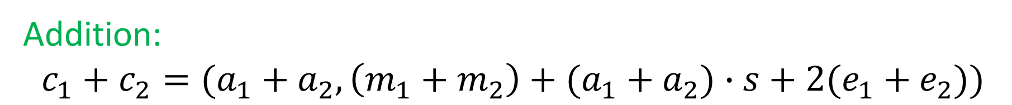
Homomorphic Properties
$c_{1}=\left(a_{1}, m_{1}+a_{1}∙s+2e_{1} \right)$, $c_{2}=\left(a_{2}, m_{2}+a_{2}∙s+{2e}_{2}\right)$
Addition:
$$c_{1}+c_{2}=(a_{1}+a_{2}, \left(m_{1}+m_{2}\right)+(a_{1}+a_{2})∙s+2(e_{1}+e_{2}))$$
Multiplication (BV):
$\left(b_{1}−a_{1}∙s\right)\left(b_{2}−a_{2}∙s\right)={(m}_{1}+2e_{1})$ ${(m}_{2}+2e_{2})$
$$=m_{1}m_{2}+2(m_{1}e_{2}+m_{2}e_{1}+2e_{1}e_{2})$$
$$\left(b_{1}−a_{1}∙s\right)\left(b_{2}−a_{2}∙s\right)=b_{1}b_{2} −\left(b_{1}a_{2}+b_{2}a_{1}\right)s+a_{1}a_{2}s^{2}$$
New ciphertext: ($a_{1}a_{2}$, $b_{1}a_{2}+b_{2}a_{1}$, $b_{1}b_{2}$) now 3 elements!
Notes:
Key switching!
Publish the encryption of s^2 under its own private key

Slide 8
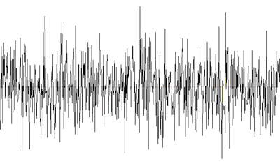
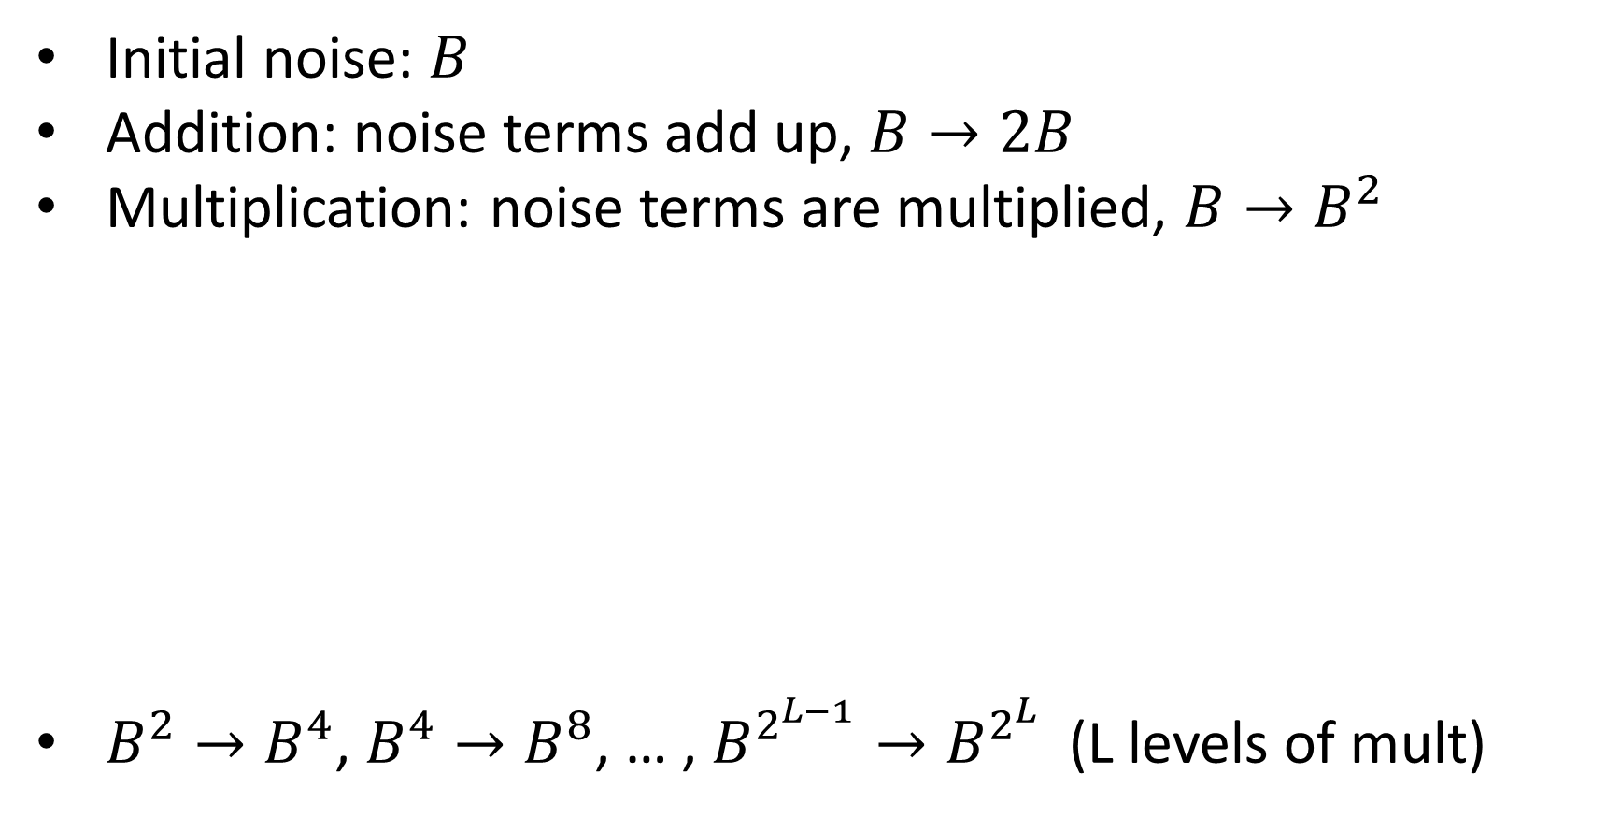
Noise Growth
Initial noise: $B$
Addition: noise terms add up, $B→2B$
Multiplication: noise terms are multiplied, $B→B^{2}$
$B^{2}→B^{4}$, $B^{4}→B^{8}$, … , $B^{2^{L−1}}→B^{2^{L}}$ (L levels of mult)
$m_{1}m_{2}m_{3}m_{4}$
𝑚_1 𝑚_2 𝑚_3 𝑚_4
$$m_{3}m_{4}$$
𝑚_3 𝑚_4
$m_{1}m_{2}$
𝑚_1 𝑚_2
$$m_{2}$$
𝑚_2
$B^{4}$ $\frac{q}{B^{4}}>2$
𝐵^4 𝑞/𝐵^4 >2
$B^{2}$ $\frac{q}{B^{2}}>2$
𝐵^2 𝑞/𝐵^2 >2
$B$ $\frac{q}{B}>2$
𝐵 𝑞/𝐵>2
$$m_{1}$$
𝑚_1
$$m_{4}$$
𝑚_4
$$m_{3}$$
𝑚_3
Notes:
Noise grows exponentially, we need huge parameters for reasonable levels

Slide 9
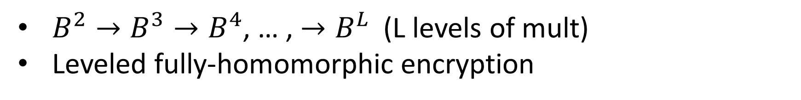

Exponential Improvement
Brakerski, Gentry, Vaikuntanathan (BGV, 2010)
Modulus Switching: Switch to a smaller modulus after each mult
Need a chain of moduli ${q=q_{0}, q}_{i}≈\frac{q_{i−1}}{B}$
$m_{1}m_{2}m_{3}m_{4}$
𝑚_1 𝑚_2 𝑚_3 𝑚_4
$$m_{3}m_{4}$$
𝑚_3 𝑚_4
$m_{1}m_{2}$
𝑚_1 𝑚_2
$$m_{2}$$
𝑚_2
$B$ $\frac{q}{B^{3}}=\frac{q_{2}}{B}>2$
𝐵 𝑞/𝐵^3 =𝑞_2/𝐵>2
$B$ $\frac{q}{B^{2}}=\frac{q_{1}}{B}>2$
𝐵 𝑞/𝐵^2 =𝑞_1/𝐵>2
$B$ $\frac{q}{B}=\frac{q_{0}}{B}>2$
𝐵 𝑞/𝐵=𝑞_0/𝐵>2
$$m_{1}$$
𝑚_1
$$m_{4}$$
𝑚_4
$$m_{3}$$
𝑚_3
$B^{2}→B^{3}→B^{4}$, … , $→B^{L}$ (L levels of mult)
Leveled fully-homomorphic encryption
Notes:
Error stays the same, parameters shrink
We need multiple moduli: modulus switching!

Slide 10
Annoying Things in BGV
Ciphertexts expand upon multiplication
Need a complicated relinearization step (key switching)
Need modulus switching to get reasonably small
noise growth
Can we do without modulus switching?
Can we avoid ciphertext expansion?
Can we achieve both at the same time?

Slide 11
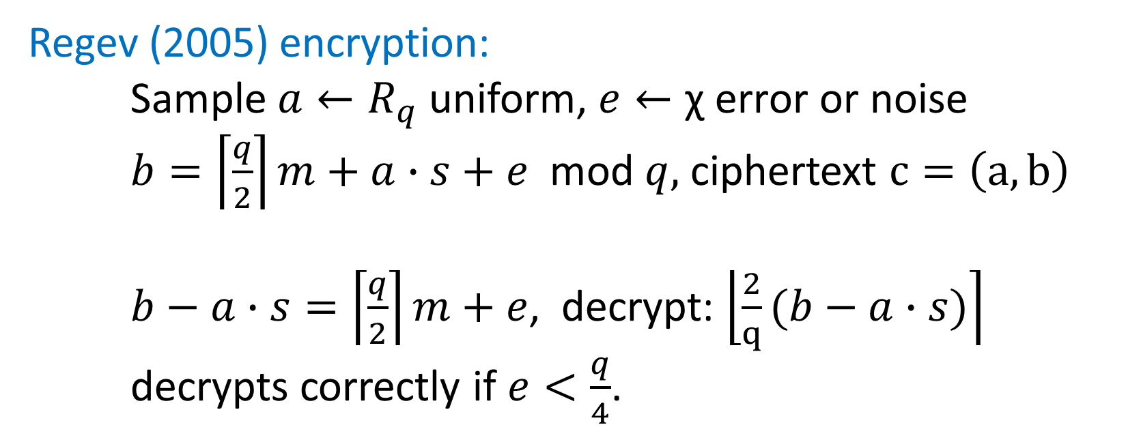
Avoiding Modulus Switching
Message $m∈\left\{0,1\right\}$
$s←\text{χ}$ secret key
Regev (2005) encryption:
Sample $a←R_{q}$ uniform, $e←\text{χ} \text{error}$ or noise
$b=\left\lceil \frac{q}{2}\right\rceil m+a∙s+e$ mod $q,$ ciphertext $c=\left(a,b\right)$
$b−a∙s=\left\lceil \frac{q}{2}\right\rceil m+e$, decrypt: $\left\lfloor \left.\frac{2}{q}(b−a∙s)\right\rceil \right.$
decrypts correctly if $e<\frac{q}{4}$.
Notes:
Instead of m small and e larger now the other way around

Slide 12
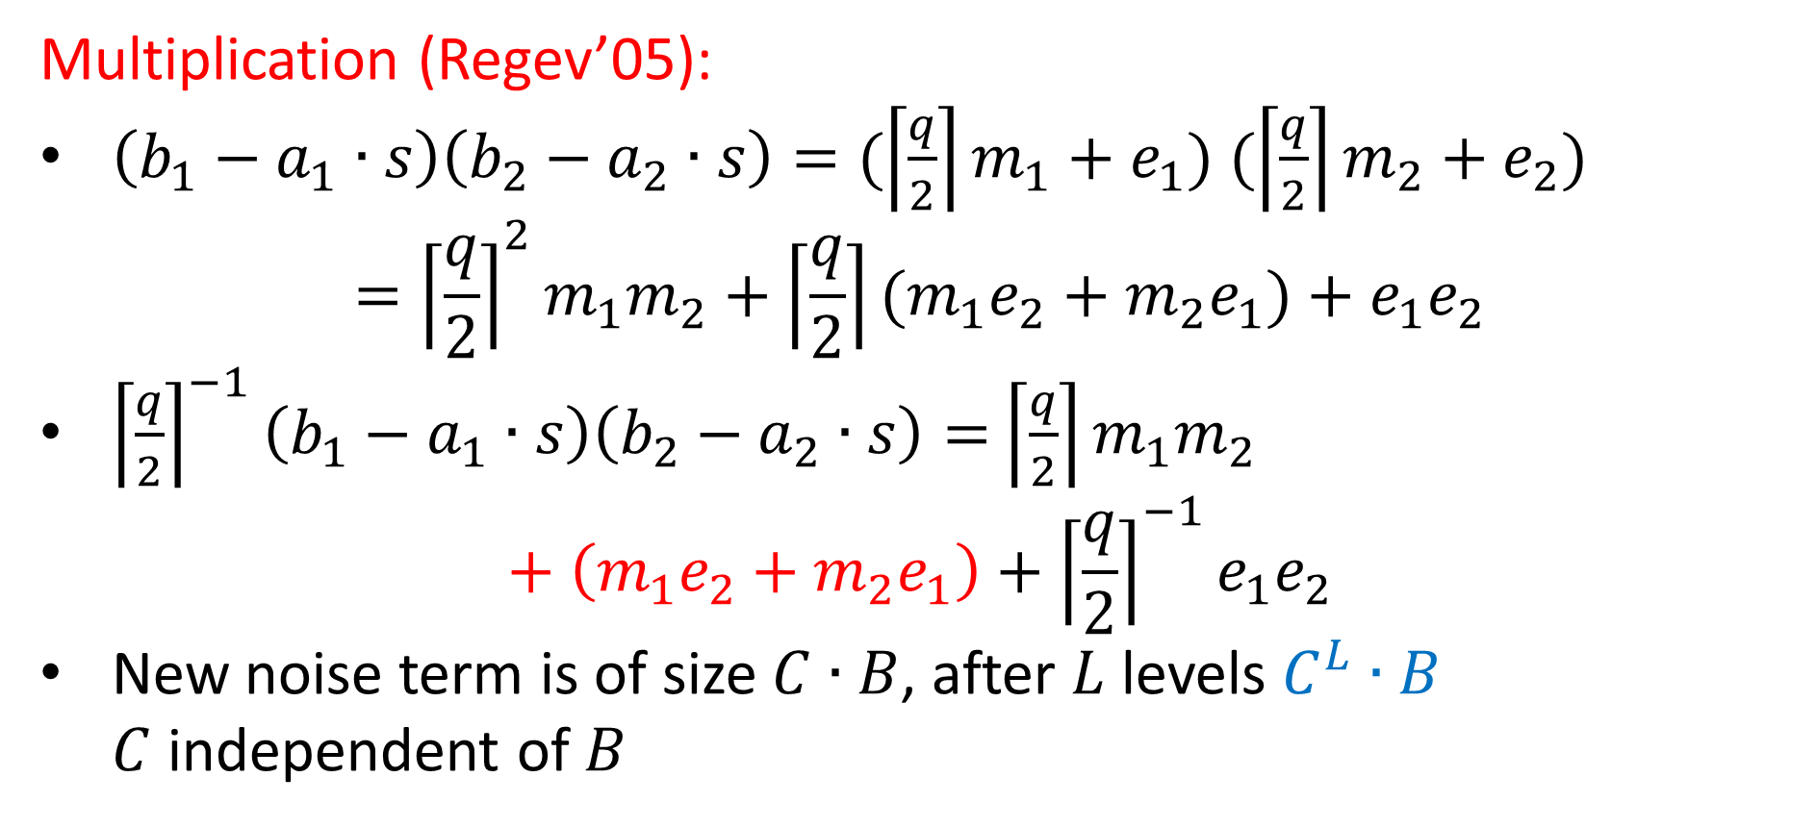
Scale-invariant Multiplication
Multiplication (Regev’05):
$\left(b_{1}−a_{1}∙s\right)\left(b_{2}−a_{2}∙s\right)=(\left\lceil \frac{q}{2}\right\rceil m_{1}+e_{1})$ $(\left\lceil \frac{q}{2}\right\rceil m_{2}+e_{2})$
$$={{\left\lceil \frac{q}{2}\right\rceil }^{2}m}_{1}m_{2}+\left\lceil \frac{q}{2}\right\rceil (m_{1}e_{2}+m_{2}e_{1})+e_{1}e_{2}$$
${\left\lceil \frac{q}{2}\right\rceil }^{−1}\left(b_{1}−a_{1}∙s\right)\left(b_{2}−a_{2}∙s\right)=$ ${\left\lceil \frac{q}{2}\right\rceil m}_{1}m_{2}$
$$+ \left(m_{1}e_{2}+m_{2}e_{1}\right)+{{\left\lceil \frac{q}{2}\right\rceil }^{−1}e}_{1}e_{2}$$
New noise term is of size $C∙B$, after $L$ levels $C^{L}∙B$
$C$ independent of $B$

Slide 13
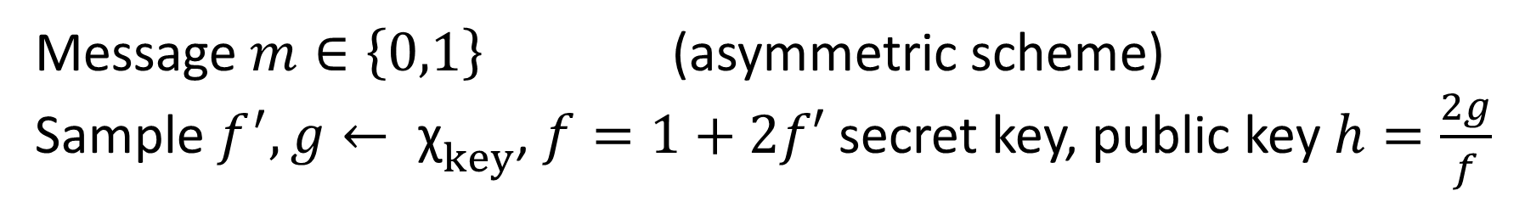
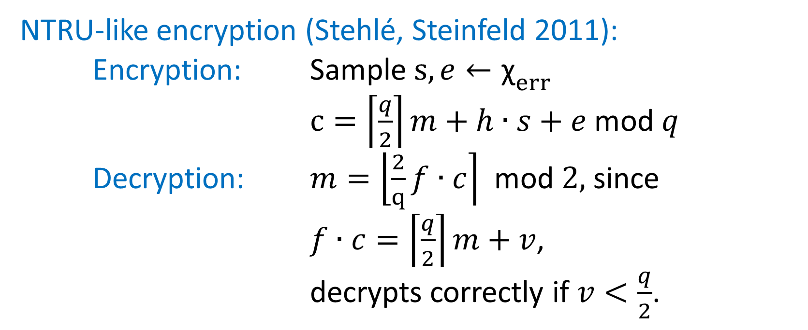
Keeping Ciphertexts at One Element
Message $m∈\left\{0,1\right\}$ (asymmetric scheme)
$\text{Sample} f^{′},g← {\text{χ}}_{key}$, $f=1+2f′$ secret key, public key $h=\frac{2g}{f}$
NTRU-like encryption (Stehlé, Steinfeld 2011):
Encryption: Sample $s,e←{\text{χ}}_{err}$
$c=\left\lceil \frac{q}{2}\right\rceil m+h∙s+e$ mod $q$
Decryption: $m=\left\lfloor \left.\frac{2}{q}f∙c\right\rceil \right.$ mod $2,$ since
$f∙c=\left\lceil \frac{q}{2}\right\rceil m+v$,
decrypts correctly if $v<\frac{q}{2}$.

Slide 14
New Leveled Homomorphic Scheme
What we have been doing over the summer
No modulus switching: only one modulus
Ciphertexts have only one element (half the size of BGV)
No ciphertext expansion after homomorphic multiplication
Still secure under RLWE (good security properties)
Parameters comparable to BGV

Slide 15
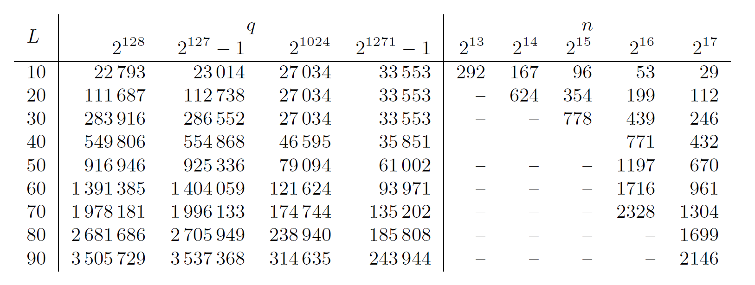
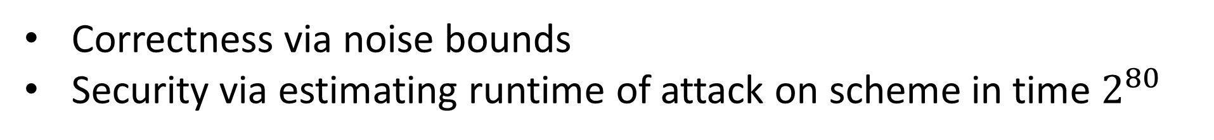
Parameters
Correctness via noise bounds
Security via estimating runtime of attack on scheme in time $2^{80}$
$R=Z\left[X\right]/ϕ_{d}\left(X\right), t=2, n=φ(d)$ of the polynomial$ϕ_{d}\left(X\right)$
Notes:
Check both security and correctness (decryptable)

Slide 16
Thank you! Questions?

